Slide 1
19.1 Algorithms
Write an algorithm to implement a linear search
Write an algorithm to implement a binary search
The conditions necessary for the use of a binary search
How the performance of a binary search varies according to the number of data items
Write an algorithm to implement an insertion sort Write an algorithm to implement a bubble sort
Performance of a sorting routine may depend on the initial order of the data and the number of data items
Write algorithms to find an item in each of the following: linked list, binary tree
Write algorithms to insert an item into each of the following: stack, queue, linked list, binary tree
Write algorithms to delete an item from each of the following: stack, queue, linked list
Show understanding that a graph is an example of an ADT.
Describe the key features of a graph and justify its use for a given situation
Candidates will not be required to write code for this structure.
Describe the following ADTs and demonstrate how they can be implemented from appropriate built- in types or other ADTs: stack, queue, linked list, dictionary, binary tree
Including use of Big O notation to specify time and space complexity

Slide 2
Today
Write an algorithm to implement a linear search
Write an algorithm to implement a binary search
The conditions necessary for the use of a binary search
How the performance of a binary search varies according to the number of data items
Write an algorithm to implement an insertion sort Write an algorithm to implement a bubble sort
Performance of a sorting routine may depend on the initial order of the data and the number of data items
Write algorithms to find an item in each of the following: linked list, binary tree
Write algorithms to insert an item into each of the following: stack, queue, linked list, binary tree
Write algorithms to delete an item from each of the following: stack, queue, linked list

Slide 3
You want to be happy….???
We done items 1-9 already in the PPT 9.0-11.0 Algorithm, Design, Data Structures and Programming in Python
So we will do the rest:
Show understanding that a graph is an example of an ADT.
Describe the key features of a graph and justify its use for a given situation
Candidates will not be required to write code for this structure.
14. Including use of Big O notation to specify time and space complexity

Slide 4
Today
14. Including use of Big O notation to specify time and space complexity
Understand: What is an ADT
Able: Use Big O notation
Answer: Why we use ADT

Slide 5
Big O Notation
Lets say you made your algorithm.
Now you want to see how good your algorithm is.
One way to measure it, is to measure how quick your algorithm is.
But we don’t say “how quick is my algorithm” we have to say ”what is the running time of my algorithm”
There are two ways to test the running time of your algorithm
Experimental Analysis
Theoretical Analysis

Slide 6
Experimental Analysis
This is where you run your algorithm and just start a timer and count how many seconds it takes for your algorithm to finish.
This was is stupid because other things will affect your speed:
Hardware of your computer
What compiler you using
What programming language you are using

Slide 7
Theoretical analysis
This method ignores a lot of things (hardware, compiler, programming language etc…) and it just counts the number of steps an algorithm takes
Steps = A unit that measures how long one operation takes.
Simple Operation = 1 step
+ , - , *, = , CALL, RETURN, IF these are examples of simple operation and are 1 step
Loops = Multiple Simple operations.
So if you loop Batman to print 5 times then is 5n steps
Memory is 0 steps so it ignores physical issues with access speed to memory

Slide 8
How many steps
How many steps does this fake code take?
Int a = b + c
Print a
3 steps
= , + and Print

Slide 9
Best, Average and Worst
When you want to work out the running time using theoretical analysis then you have to measure 3 things:
Best Case
Average Case
Worst Case
Best case = If everything is super perfect
Average case = The median average
Worse case – If everything goes bad
There’s a problem with Best case and Average Case
Your best case may take 2 seconds and be super quick, but your average case could be 4 years and your worst case is 89 years. So who really cares about your Best Case because its likely that the Best Case will never happen.
So just pick average case, right?
Nope.
You could, but average case is hard to calculate and you still are thinking that maybe your computer has some good things
So we calculate the worst case because then at least you guaranteed that it will take ”this” time or less

Slide 10
Big O Notation
Big O = A way of showing how quick math functions grow
But we only care when the inputs used are large inputs
With Big O notation, you remove two things:
1. Constant Factors
2. Lower order terms
Constant factors = the constant values that a term is multiplied by
Example: 5n. 5 is the constant value of n, therefore 5 is the constant factor
Lower Order Terms = If all the variables are the same, the first term with the highest exponent is the LEADING ORDER term. All the others are the LOWEST ORDER terms, we remove the LOWER ORDER.
Example: 5n⁴ + 3 + n² + n³ The first term is n⁴. The lower order terms are 3, n² and n³. We remove these
Notes:
https://www.data-structures-in-practice.com/big-o-notation/

Slide 11
Example
With these two examples:
Example 1: f(n) = 8n + 69
Example 2: f(n) = 4n
From Example 1, we can remove the constant value of 8 and the +69
From Example 2, we can remove the constant value of 4
So both can be written as
O(n)
Order of n

Slide 12
Why do we remove?
We remove the constant factors and lower order terms because they don’t really make that big of a difference.
So if you look at these 4 formulas:
Example 1: A = n Example 2: A = 2n Example 3: A = 3n Example 4: A = n²
And then plot these formulas on a graph, Example 1, 2 and 3 barely change anyway
Example 4 has a bigger change

Slide 13
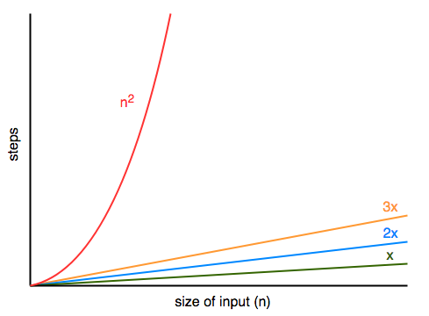
Why do we remove?
4 formulas:
Example 1: A = n Example 2: A = 2n Example 3: A = 3n Example 4: A = n²
And then plot these formulas on a graph, Example 1, 2 and 3 barely change anyway
Example 4 has grows much more

Slide 14
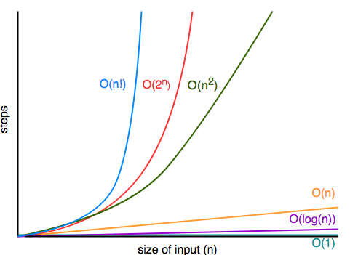
Types of Big O
There are 5 types of Big O
O(1) = Constant
O(log n) = Logarithmic
O(n) = Linear
O(n²) = Quadratic
O(2^{n}) = Exponential

Slide 15
O(1) = Constant
No matter how large the inputs are, your algorithm will take the same number of steps.
Example when you sum(add) two numbers. It doesn’t matter how large those numbers are.
int sum(int a, int b)
{
return a + b;
}

Slide 16
O(log n) = Logarithmic
These functions grow slowly because they halve the amount of data they work with for each iteration
An example of this is a Binary search, as every time it runs, it halves the amount of data it looks at.
The following table shows how many steps it takes.
You can see that 100 takes 7 steps and 100,000,000 only takes 27.
Input | Steps
100 | 7
1000 | 10
10,000 | 13
100,000 | 16
1,000,000 | 20
100,000,000 | 27

Slide 17
O(n) = Linear
These functions grow linearly with n
They are good and handle large inputs
An example is if you want to find the exponent of a number.
int exp(int base, int e)
{
int total = 1;
while(e)
{
total *= base;
e--;
}
}

Slide 18
O(n²) = Quadratic
These grow very quickly.
Imagine if you have an array (list in Python) and you want to check if there are any duplicates in your list.
One way to do this is to loop the previous item to see if it matches with the current item.
So a nested For loop.
This is an example of a quadratic algorithm
bool contains_duplicates(int arr[], int n)
{
for (int i = 0; i < n; i++)
{
for (int j = 0; j < i; j++)
{
if (arr[j] == arr[i] && i != j)
{
return true;
}
}
}
return false;
}

Slide 19
O(2^{n}) = Exponential
Grow even faster than quadratic
It means they are very slow
An example (that was stolen from website) is if you want to find the n^{th} term in the Fibonacci sequence
int fib(int n)
{
if (n <= 1)
{
return n;
}
return fib(n - 1) + fib(n - 2);
}

Slide 20
Big O Notation+ / -
± Used to measure how fast your algorithm is
± 5 variants of Big O Notation
± Stolen from Maths
+ Standard way
Ignores constants, and if the constant is large it could make a difference if the input is small
Hard to compare algorithms because if you look at the formula we have removed things
The worse case is rare, but we still use it as the measurement to use.

Slide 21
Today
10. Show understanding that a graph is an example of an ADT.
11. Describe the key features of a graph and justify its use for a given situation
Understand: What is a graph data type
Able: Recognize the features of a graph data type
Answer: Where we use the graph data type

Slide 22
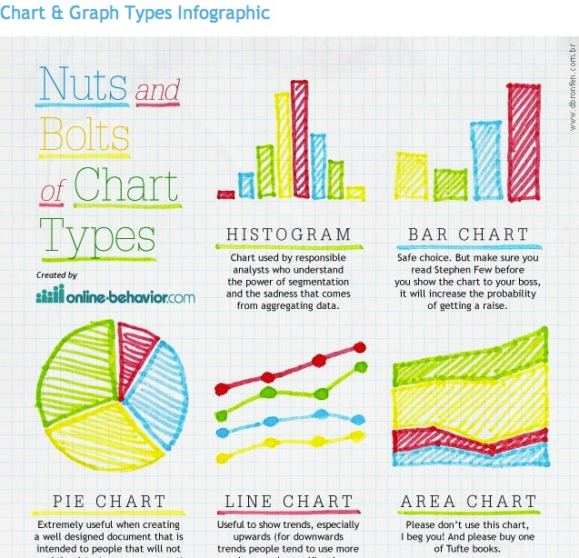
For Computer Science…..Is this a Graph?
NO

Slide 23
For Computer Science…..Is this a Graph?
NO

Slide 24
For Computer Science…..Is this a Graph?
NO

Slide 25
For Computer Science…..Is this a Graph?
YES
JUST JOKING. IT’S NO

Slide 26
For Computer Science…..Is this a Graph?
YES
Really, Yes

Slide 27
Graphs in Computer Science
It’s a data type.
But not like integer or string data type, Graphs are an Abstract Data Type (ADT)
And to even call it an ADT is a bit stupid because a graph doesn’t actually hold anything.
It’s just a way to show:
If there is a relationship between two things
Help you see the shortest path

Slide 28
Terminology
This graph shows 2 dots and a line
Nope.
Instead of dot we have to say vertex
Instead of line we have to say edge
And if you have more than one vertex then its called vertices
Annoying part….
Vertex / Vertices can also be called Points. Can also be called Nodes
Edge can also be called Arc. Can also be called Links. Can also be Paths. Can also be called Lines…… (but don’t say lines)
So this graph has:
2 vertices and one edge
Notes:
https://medium.com/@BennettGarner/what-the-graph-a-beginners-simple-intro-to-graphs-in-computer-science-3808d542a0e5
https://en.wikipedia.org/wiki/Graph_(abstract_data_type)
http://web.cecs.pdx.edu/~sheard/course/Cs163/Doc/Graphs.html

Slide 29
Different types of graphs
All graphs are made up of vertices / nodes and edges
But there are different types of graph
Undirected
Directed
Vertex labelled
Cyclic
Acyclic
Edge labelled
Weighted

Slide 30
Undirected
These just show the nodes and paths
No other information

Slide 31
Directed
Shows the order of the nodes
Shows the direction you must go
The paths have arrows

Slide 32
Vertex Labelled
A
B
Each vertex has a label.
Can be undirected or directed
Can be cyclic or acyclic (we will do this next)
Each vertex should have a unique label
C
A
B
C

Slide 33
Cyclic
A
B
If you can start from one node and follow your graph and return to the node you started with. It’s a cyclic graph
It has a loop
Not everything in the graph as to be in the loop, as long as there is a loop
Can be undirected or directed
C
D
A
B
C
D

Slide 34
Acyclic
A
B
There is no loop. Its not Cyclic
Can be undirected or directed. Usually directed.
Look at the directed graph. There is no loop
(The difference is this one, A goes to C, whereas in the previous cyclic graph C went to A)
C
D
A
B
C
D

Slide 35
Edge labelled
If vertex labelled put labels on the vertices, edge labelled puts labels on the edges.
Can be vertex labelled or not vertex labelled
Can be undirected or directional
Can be cyclic or acyclic
Each edge label should be unique
Edge1
Edge2
Edge3
A
Edge1
B
Edge2
Edge4
C
D
Edge3

Slide 36
Weighted Graph
Same as edge labelled.
But the edge labels are not just random labels but a number.
This numbers can be used to perform some arithmetic operation
So if we start at A and want to go to D
We can go direct A > D with a cost of 84
Or go A > B > C > D with a cost of 13
(5 + 6 + 2)
The weighted labels can be the same
84
A
5
B
6
2
C
D
2

Slide 37
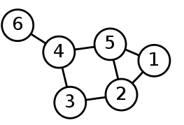
How to write graphs
So you can draw graphs with dots and lines, vertices and edges.
But how can you write graphs
You write them as sets within brackets:
Vertices sets lists all your vertices
Edge sets lists all the links between vertices
Vertices set:
{1, 2, 3, 4, 5, 6}
Edge set:
{(6,4), (4,5), (4,3), (5,2), (5,1) (3,2), (2,1)}

Slide 38
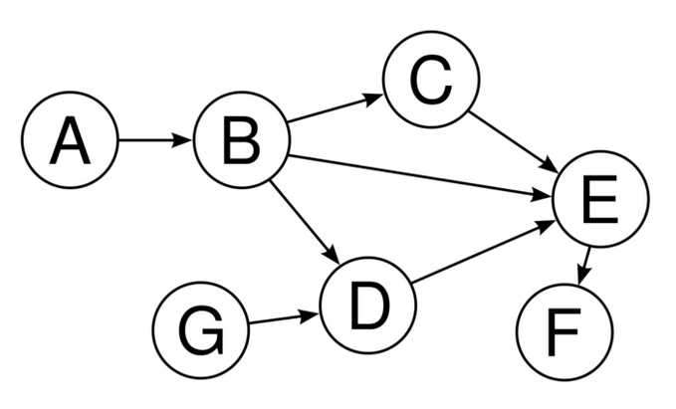
Task
Q1. Is this graph edge labelled?
Q2. Is this graph arc labelled?
Q3. Is this graph node labelled?
Q4. Is it cyclic?
Q5. Is it directional?
Q6. What is the vertices set?
Q7. What is the edge set?
A1. No
A2. No
A3. Yes
A4. No
A5. Yes
A6. {A,B,C,D,E,F}
A7. {(A,B), (B,C), (B,D), (B,E), (C,E), (D,E), (E,F), (G,D)}

Slide 39
Another way to write graphs
So one way is this:
Vertices set: {1, 2, 3, 4, 5, 6}
Edge set: {(6,4), (4,5), (4,3), (5,2), (5,1) (3,2), (2,1)}
Another way is:
graph1:: Graph Int graph1 6 = [4] graph1 5 = [1,2,4] graph1 4 = [3,5,6] graph1 3 = [4,2] graph1 2 = [1,3,5] graph1 1 = [2,5] graph1 _ = [ ]
But that still only says the vertices labels, so there is another way to include the edges

Slide 40
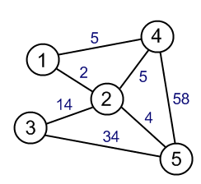
One more way to write graphs
graph6:: ELgraph Int Int
graph6 1 = [(4,5),(2,2)]
graph6 2 = [(1,2),(4,5),(3,14),(5,4)]
graph6 3 = [(2,14),(5,34)]
graph6 4 = [(1,5),(2,5),(5,58)]
graph6 5 = [(2,4),(3,34),(4,58)]
graph6 _ = []

